Slide 1
Why are You A Marketing Student? Second Project Illustration
Dr. Jack A. Lesser
Presented to Mktg. 3300 Students
At U of M Crookston

Slide 2
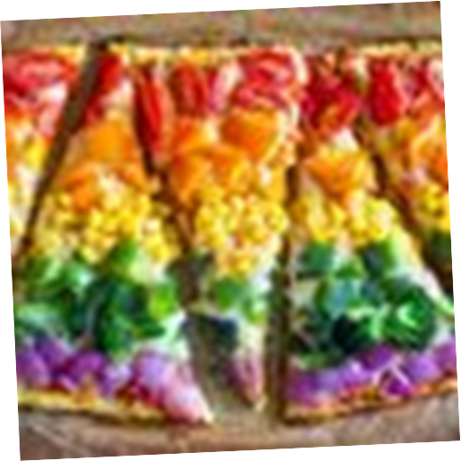
Overview of Market Segmentation and Consumer Attention Processes
“Good marketers see consumers as complete human beings with all the dimensions real people have.”—Jonah Sachs) -- psychographics
“Genius is nothing but continued attention.”– Claude Adrien Helvetius -- attention and sustained innovation
“The point to remember about selling things is that, as well as creating atmosphere and excitement around your products, you've got to know what
you're selling.”—Stuart Wilde
-- information expertise

Slide 3
Second Phase of Project
I. Global Customers and Markets
a. What features of you product are especially important to
potential customers?
b. In which countries do these customers live?
c. What special marketing issues are involved in trying to
reach them?
II. Target Market Segmentation
a. Define the market segment (s) (rows in your product
market grid) using the bases of psychographic segmentation
used to segment consumer and organizational markets
b. Define the groupings of related products (the columns
in your grid)
c. Form your product/market grid and estimate the size of
the market
d. Select and explain target market segment (s) on which to focus
your efforts.

Slide 4
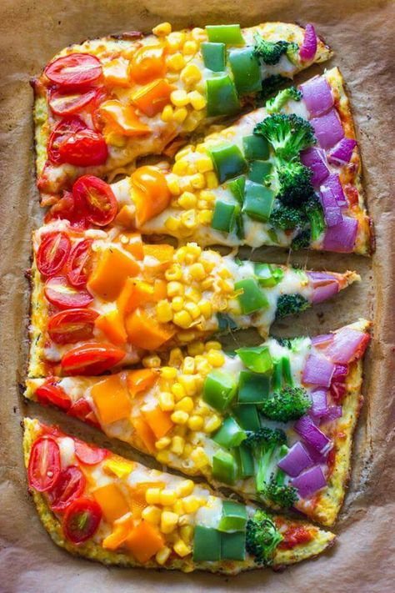
Second Project Phase, Cont.
Target market
Size
Products (Here, Meals)
Early Adopter
Early Majority
http://www.ondigitalmarketing.com/learn/odm/foundations/5-customer-segments-technology-adoption/
Define and Explain Psychographic Target Market (s)
Estimate (and Research/Support) Rough Sizes
Determine Primary Products/Lines
Estimate Approximate Prices
Determine Rough Demand (target market sixe x
product price (s)

Slide 5
Some Notes About Steps
Psychographic Segment.
Explain a number of the psychological qualities, as though you have met the person before.
Do NOT use demographics or other non-psychographic qualities until you have clearly explained psychographic segment.
Estimate Rough Sizes. (revenues)
Relevant, but you may well need to make educated guesses.
Determine Primary Lines Carried.
Determine Rough Demand.
Demand = quantity x price charged

Slide 6
Second Project Phase, Cont., Using Ophelia Cafe
Segment and segment size:
Fifty-eight percent (58%) of American Adults now say they are dining out at least once a week, according to a new Rasmussen Reports national telephone survey. That’s virtually unchanged from January and includes 40% who say they typically go out to a restaurant once a week, 14% who go out two or three times a week and four percent (4%) who dine out more than three times a week. Thirty-nine percent (39%), on the other hand, rarely or never eat at a restaurant. http://www.rasmussenreports.com/public_content/lifestyle/general_lifestyle/july_2013/58_eat_at_a_restaurant_at_least_once_a_week

Slide 7
Second Project Phase, Cont., Using Ophelia Cafe
Number and percentage in Segment:
Early Adopters = 13.5%; Early Majority = 34% and perhaps the most innovative half of these consumers. = 30.5%
Number of Households in Grand Forks, ND and Freq. of Visits:
22,260 households + 10% from East Grand Forks and visitors = 24,486 households; 2.1 in a household = 51,420.6 customers
40% eat once per week
14% eat 2.5 times per week
4% eat 4 times per week.
(51,420 x .40 x 1) + (51,420 x .14 x 2.5) +
(51,420 x .04 x 4) = 8332 + 7290.5 + 3332.8 =
visits per week x 13.5% (Early Adopters) x 12.5%
chance to eat at Ophelia Café (about 8 cafes) =
46,792 customers x 30.5% x 12.5% = about 1784
customers per week.
How Much Customers Spend, on Average, for Products?
Tingting Chen’s Research –

